Slide 1
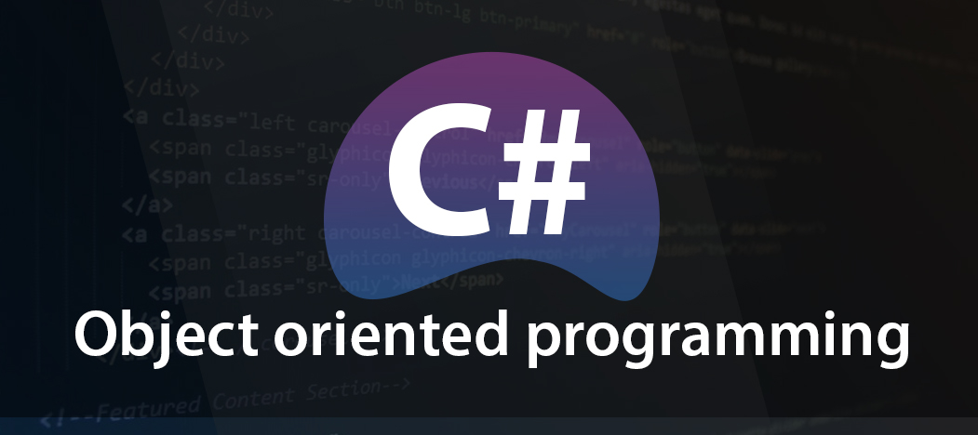


Slide 2
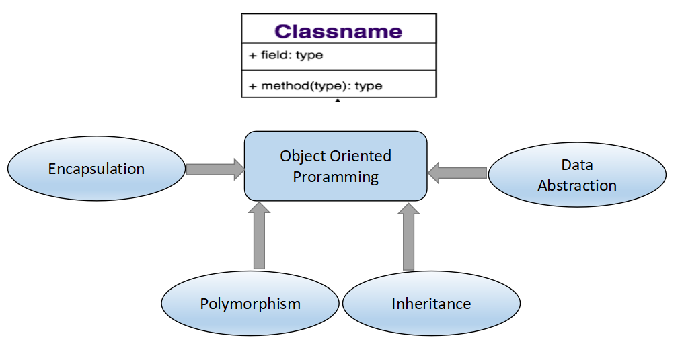
Object Oriented Programming
C# is an true Object oriented language based on classes
Object is an entity that has state and behavior

Slide 3
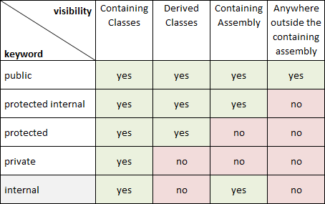
Encapsulation/Data Hiding
Hide the internal details of an object from its users
Modifier | Description
public | accessible for all classes
private | only accessible within the same class
protected | accessible within the same class, or in a class that is inherited from that class.
internal | only accessible within its own assembly, but not from another assembly.

Slide 4
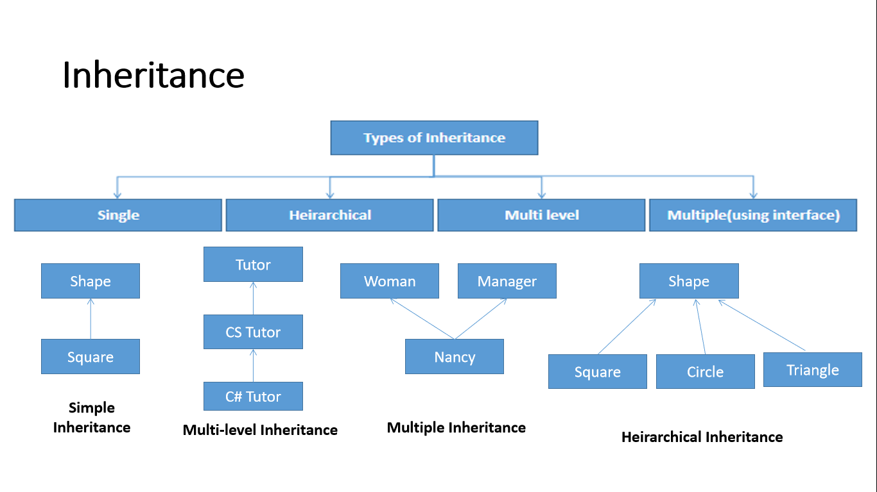
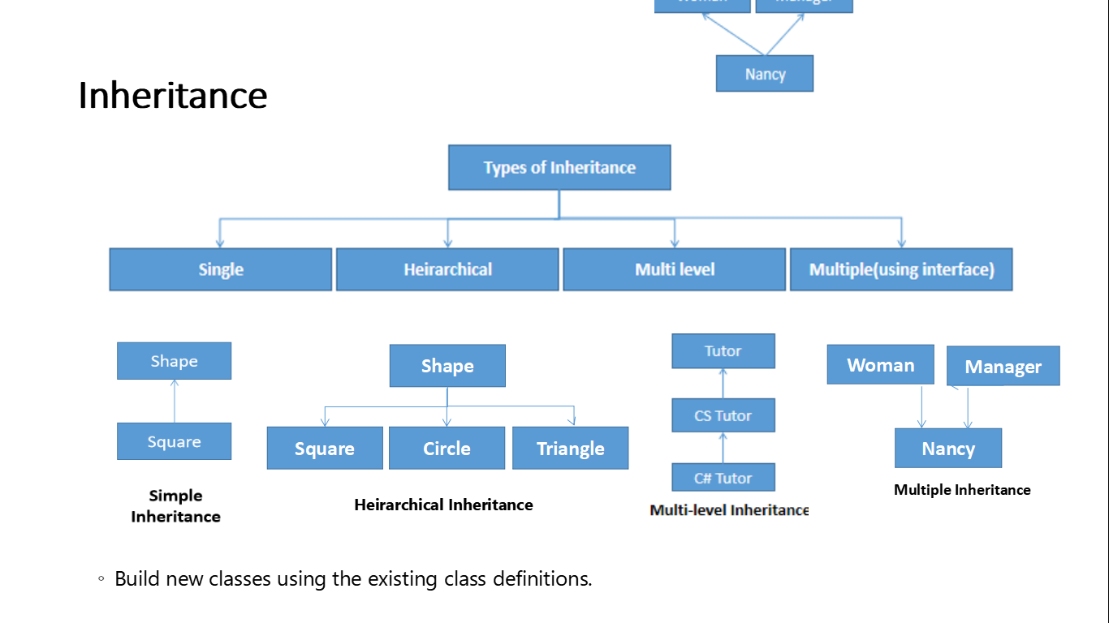
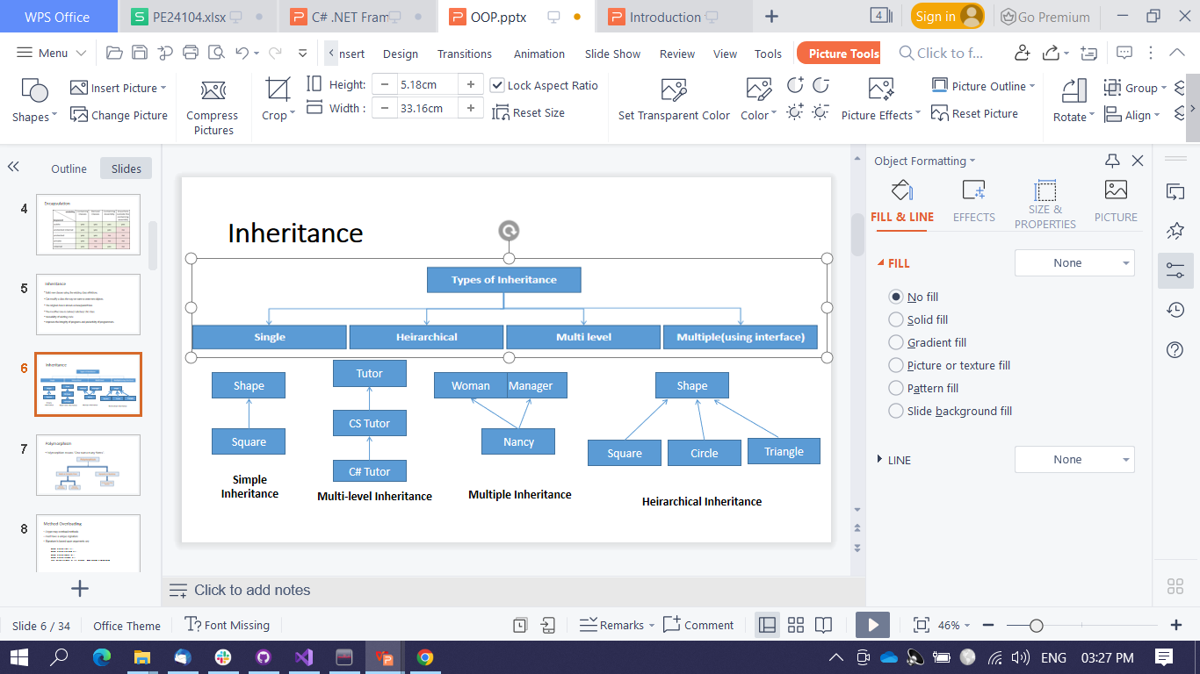
Inheritance
Build new classes using the existing class definitions.

Slide 5
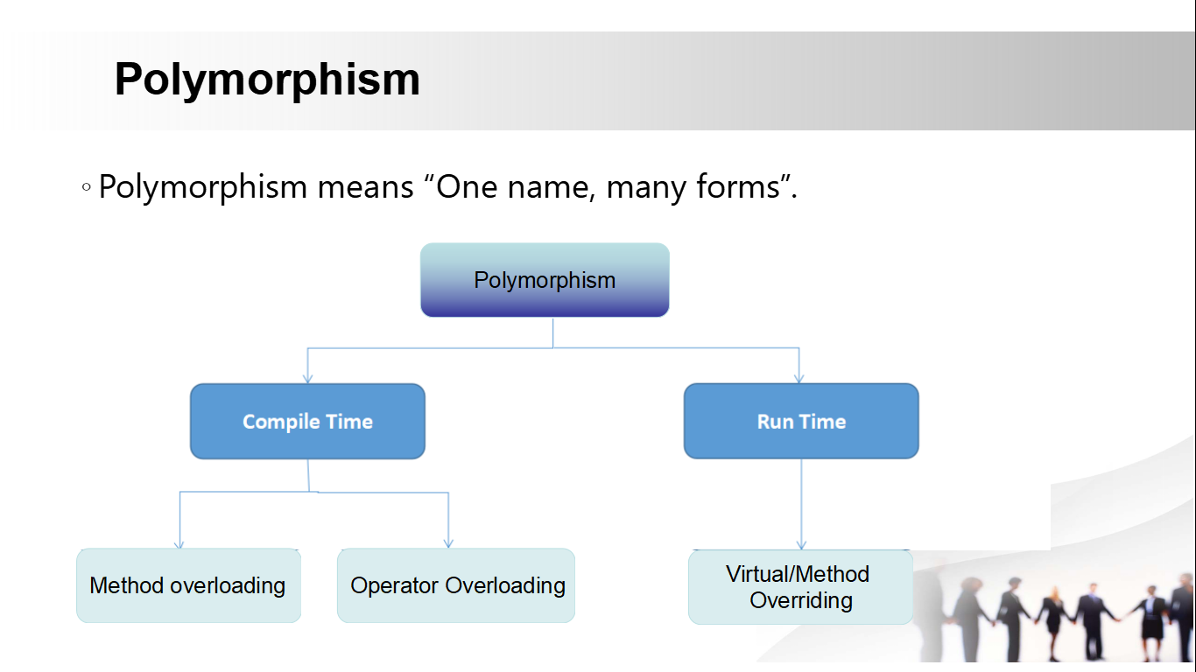
Polymorphism
Polymorphism means “One name, many forms”.

Slide 6
Method Overloading & Method Overriding
Method Overloading | Method Overriding
Occur within the class | Performed in 2 classes with inheritance
May/May not require inheritance | Always needs inheritance
Method must have same name and Different signature | Methods must have same name and Same signature

Slide 7
Operator Overloading
Operator overload methods can't return void.The overloaded methods should differ in their type of/and/order/number of arguments.
User-defined operators
Must be a static method
eg:
class Car
{
string vid;
public static bool operator==(Car x, Car y)
{
return x.vid == y.vid;
}
}

Slide 8
Boxing
It is the process of converting the object type back to the value type.
eg:
int m =10;
object om = m; //Box m
int n = (int) om;//Unbox om back to an int
UnBoxing
The conversion of a value type on the stack to an
object type on the heap.
eg:
int m = 10;
object om = m;// Creates a Box to hold m
m = 20;
Methods
Fields
Syntax:
modifiers type method-name (formal parameter list)
{
//Method Body
}
Syntax to invoke a method:
objectname.methodname(actual parameter list);
A Member variable holds data for a class or struct
A Class/struct/array instanceTo access a field in an instance
instancename._fieldName.
eg:
CalendarEntry birthday = new CalendarEntry();
birthday.Day = "Saturday";

Slide 9
Property
Provides a flexible mechanism to read, write, or compute the value of a private field.
A get property accessor - return the property value
A set property accessor - assign a new value.
The value keyword - define the value being assigned by the set or init accessor.
This can be
- read-write (both get & set accessor)
- read-only (only get accessor)
- write-only (only set accessor)
Syntax:
<access_modifier> <return_type> <property_name>
{
get { // body }
set { // body }
}

Slide 10
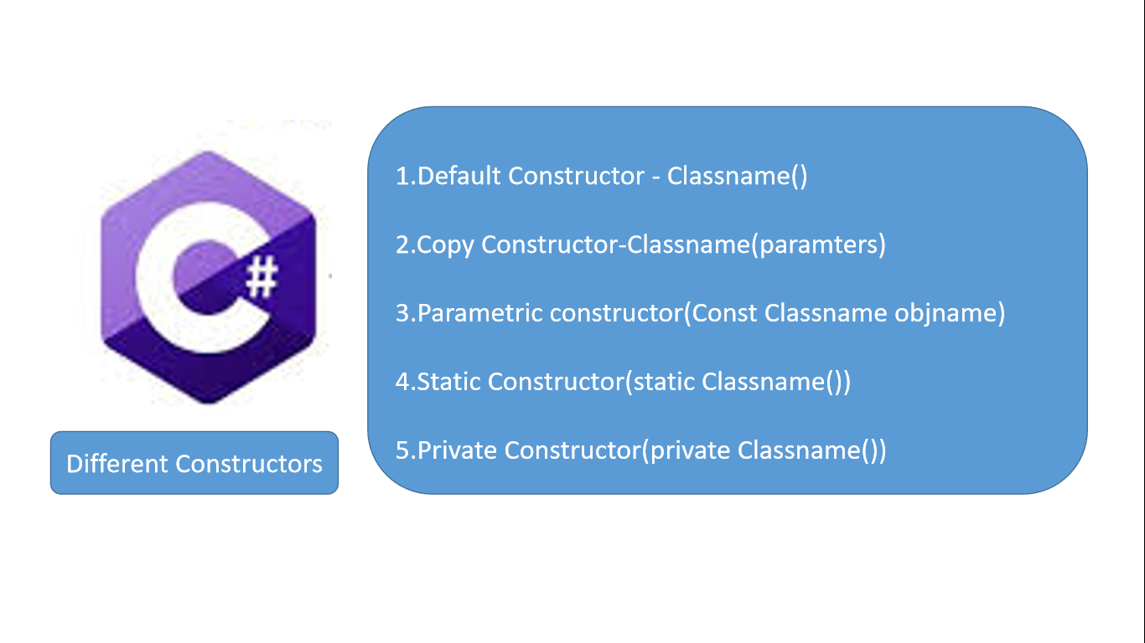
Constructor | Destructor
Used to initialize an instance of a class | Used to delete or destroy the objects
Invokes when Class instance created | Invokes when instance is destroyed
memory allocation | Releases the memory
Overloang is possible | Overloading is not allowed
They are allowed to have arguments | No arguments can be passed in a destructor
same name as the class | starts with a tilde(~)

Slide 11
Interface
eg:
interface IControl
{
void Paint();
}
interface IListBox: IControl
{
void SetItems(string[] items);
}
interface IComboBox: ITextBox, IListBox
{
}
An interface is a type & defines a contract
Includes methods, properties, indexers, eventsWhen a class or struct implements an interface.
This provide polymorphism
Interfaces can inherit from multiple interfaces

Slide 12
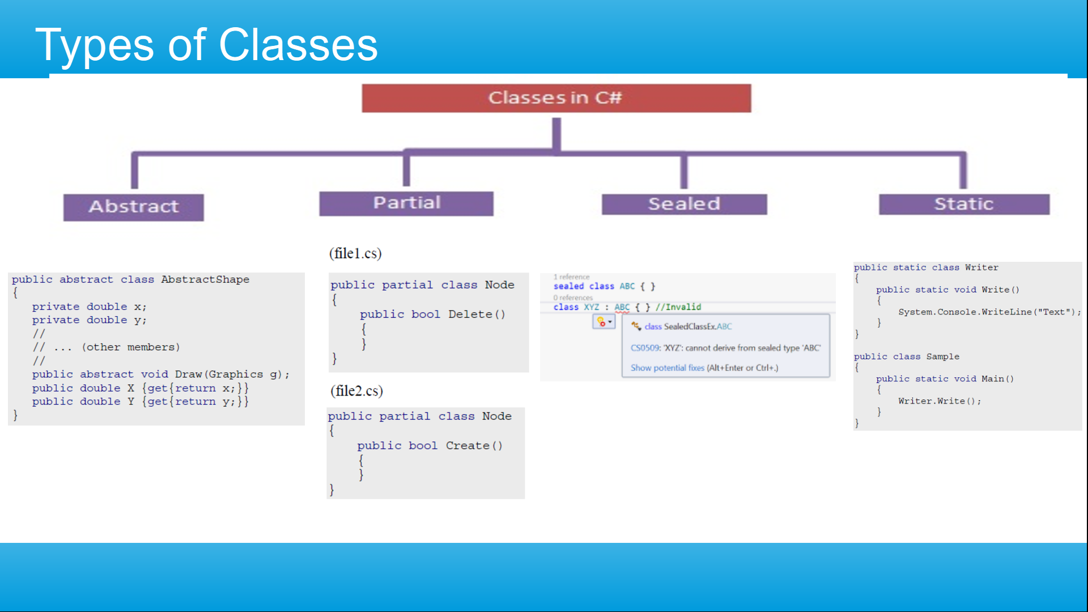

Slide 13
Sealed Class
Using Sealed
keyword
No name can be
derived
Sealed
Class
Used to restrict the
users from inheriting
the class
Declared as a method
s as sealed, declare
as virtual in its base
class

Slide 14
Static Class
Using Static
keyword
Can be accessed
using Classname.
MemberName
Static
Class
Cannot be
instantiated
Defined as static
using the static
modifier keyword

Slide 15
Abstract Class
Abstract class
can have abstract
and non-abstract
methods
Declared with
keyword abstract
It can have
constructors and
static methods
Abstract
Class
Cannot be
instantiated
It can have final
method

Slide 16

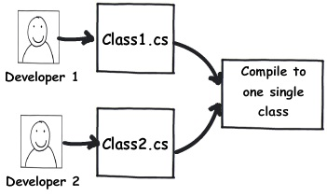
Partial Class
Partial Class
Must be in the same assembly and namespace.
The Partial modifier can only appears before the keywords class, struct, or interface.
Nested partial types are allowed.
Partial Method
Must use the partial keyword and must return void.
Can have in or ref but not out parameters.
Implicitly private methods, so cannot be virtual.
Can be static methods.
Can be generic.

Slide 17
Virtual Methods
Non-virtual
methods are not
polymorphic
Methods may be
virtual or
non-virtual
(default)
class Pgm {
public void DoSomething(int i) {
...
}}
Virtual
Methods
They cannot be
overridden
Non-virtual
methods cannot
be abstract
Pgm p = new Pgm(); f.DoSomething();

Slide 18
This Keyword
Predefined
variable available
in nonstatic
function members
Static members
of a class/struct
do not have a
this pointer
this
Represents the
current instance
of a class/struct
It is also used on
hidden fields
public Student(int id, String name, int age, String subject)
{
this.id = id;
this.name = name;
this.subject = subject;
this.age = age;
}

